Slide 1
NEP improvements
Reported By : Nasser AL Nabhani

Slide 2
While NEP is Sync with multiple System and this is a good feature , we are suggesting below points to enhancement NEP and will be usefully for team and avoid human mistake

Slide 3
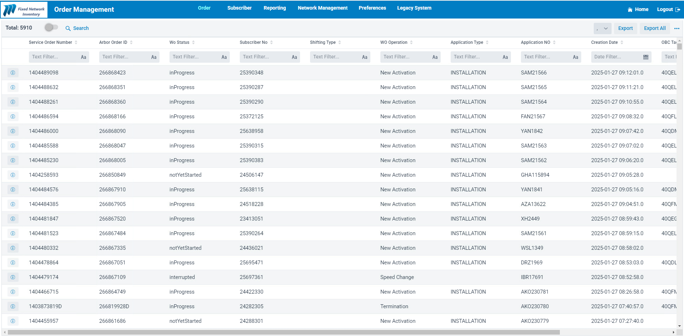
Add new Cullom for Region
1- In Order Management ( Add new Colum for Region ) It will be easy when export data and filter it by region.

Slide 4
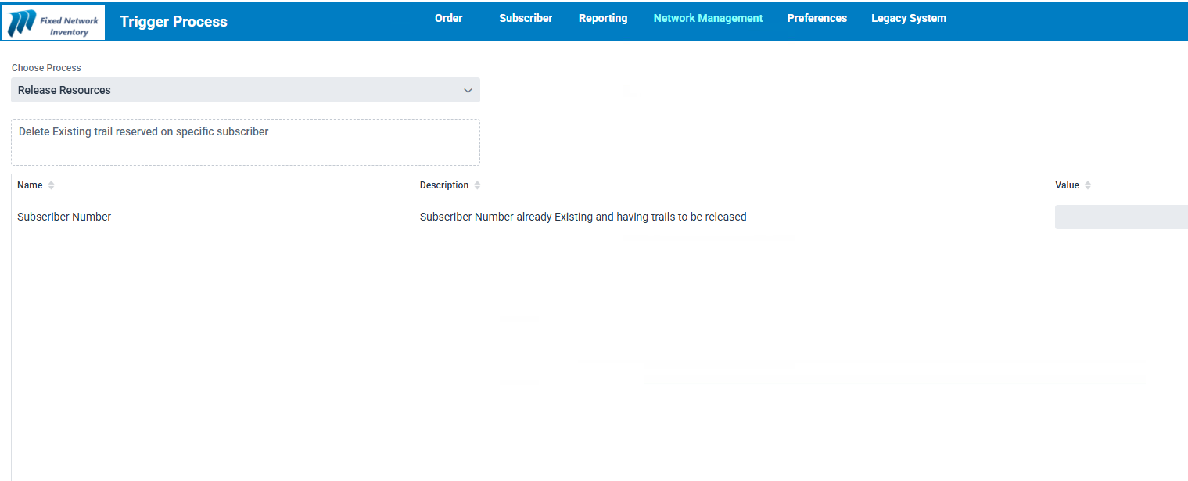

2- In Trigger Process ( Add new Process Switching Voice Release Resources) It will be easy when we want to delate voice resource .
Switching Voice Release Resources
1
PSTN
OR
GPON
2
These option should be design by select
NGN
OR
IMS
3
Notes:
First Slide

Slide 5

3- In Trigger Process ( Add new Process Switching update Voice password_ GPON) It will be help us when we want to update Password voice either NGN or IMS.
Switching update Voice password_ GPON
2
1
New voice Password
I suggest the new password generate by system
NGN
OR
IMS
3
These option should be design by select
Huawei
OR
Fiber home
On this option require 2 path : first to Soft switch , Second to NE
4

Slide 6
4- In Trigger Process ( Add new Process Release ONT _Resources from NE )
It will be help us when we want to release ONT _Huawei or Fiberhome
Release ONT _Resources from NE
1
OR
Serial number
Huawei
OR
Fiber Home
2
3

Slide 7
Request to Reactivate SW ( voice ) .
5- This function is returned to Reactive voice only by iLink
This feature will be very beneficial for our service delivery team, as it will help us to avoid errors and provide support more quickly.

Slide 8
6- This function is returned to Reactive Data only by iLink
Request to Reactivate SW ( Data ) .
This feature will be very beneficial for our service delivery team, as it will help us to avoid errors and provide support more quickly.
Notes:
First Slide

Slide 9
7- This function is returned to Reactive V&D only by iLink
Request to Reactivate SW ( V&D ) .
This feature will be very beneficial for our service delivery team, as it will help us to avoid errors and provide support more quickly.

Slide 10
Thank You

